Slide 1

SQL Injection
What it is and how to defend against it
By AppJedi
www.appjedi.net

Slide 2
SQL Injection
SQL Injection (SQLi) is a type of security vulnerability that allows attackers to manipulate a website or application's SQL queries by injecting malicious input into fields intended for user data. This vulnerability can lead to unauthorized access to databases, allowing attackers to view, modify, or delete sensitive information.

Slide 3
SQL Injection Example
username = request[‘username’]
password = request[‘password’]
query =“SELECT * FROM users WHERE username = ‘“+username+”’ AND password = ‘”+password+”’”
If user enters:
username = “admin’ -- ”
password = “anything”. -- Will be ignored by SQL comment – (dash dash)
Query Executed:
SELECT * FROM users WHERE username = ‘admin’;
-- is a comment in SQL so the password part is ignored.

Slide 4
SQL Injection fix
The prior example used dynamic SQL.
Dynamic SQL is a sql statement created at runtime using a string and values concatenated into the string.
Solutions:
Prepared Statements.
Stored procedures.
Validate user input.
Principle of least privileges.

Slide 5
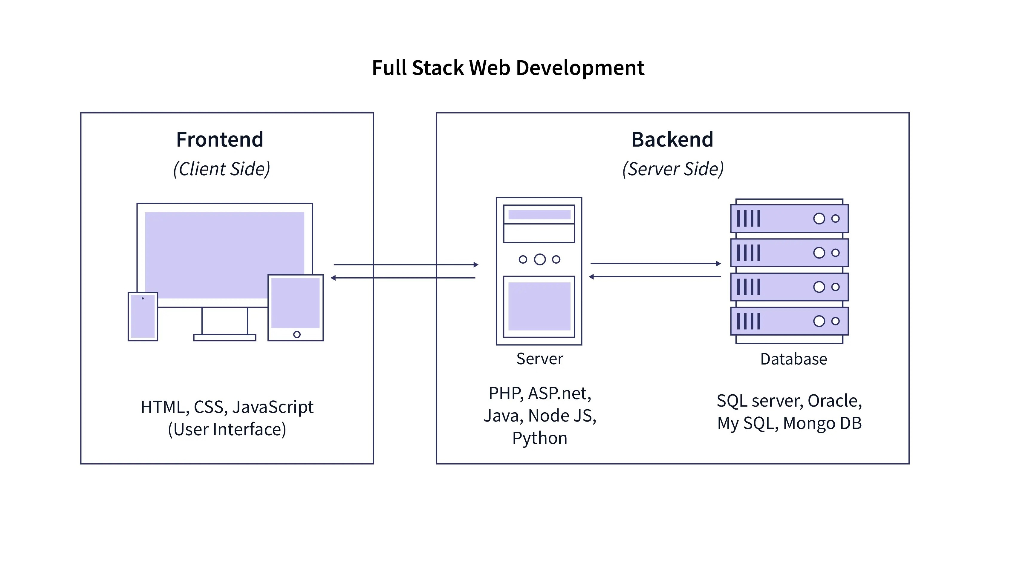

Slide 6
Dynamic SQL example:
const sql =
`SELECT * FROM users WHERE username = '${user.username}' AND password = '${user.password}’`;
console.log("LOGIN:", sql);
const resp = await this.query(sql);
console.log("DAO.RESP:", resp[0]);
if(resp[0]===undefined || resp[0].user_id<1) {
return [{status:0, message:"User Not Authenticated"}];
}else{
return [{status:1, message:"User Authenticted", user_id: resp[0].user_id, username: resp[0].username}];
}

Slide 7
Prepared Statement
Prepared statements are pre-compiled and static not dynamic.
const sql = "SELECT * FROM users WHERE username =? AND password =?";
const values =[user.username, user.password];
console.log("LOGIN:", sql,values);
const resp = await this.query(sql,values);
console.log("DAO.RESP:", resp);
if(resp[0]===undefined || resp[0].user_id<1) {
return [{status:0, message:"User Not Authenticated"}];
}else{
return [{status:1, message:"User Authenticted", user_id: resp[0].user_id, username: resp[0].username}];
}

Slide 8
Stored Procedure
Stored procedures are also pre-compiled and static not dynamic.
const resp=await this.call("usp_user_auth", [user.username, user.password]);
console.log (“resp from sp:”,resp);
return resp;
resp from sp: [
{
status: 1,
message: 'User Authenticated',
userId: 2,
username: 'testerb',
roleId: 1
}
]

Slide 9
Stored Procedure
CREATE PROCEDURE `usp_user_auth`(IN `p_username` VARCHAR(50), IN `p_password` VARCHAR(50))
main: BEGIN
DECLARE userId INT;
DECLARE roleId INT;
SET userId=0;
SELECT user_id, role_id INTO userId, roleId FROM users WHERE username=p_username AND password=p_password;
IF userId >0 THEN
SELECT 1 AS `status`, 'User Authenticated' AS message, userId, p_username AS username, roleId;
ELSE
SELECT -1 AS `status`, 'User NOT Authenticated' AS message,userId, p_username AS username, 0 AS roleId;
END IF;
END

Slide 10
Why Stored Procedures?
Database defends itself, not dependent on the application.
Additional layer of security and abstraction. Table and column names hidden from the application. (Principle of least privilege)
Protects against SQL Injection.
Reduced Network Traffic.
Shared between multiple app clients.
Centralize data processing.
I will be producing a full video on stored procedures.

Slide 11
Data Validation
Data validation should always be done on the server. By server that could be the app server or database server but I recommend the database server.
We could add this snipped to our stored procedure:
IF p_username LIKE '%--%' OR p_username LIKE '%''%' THEN
INSERT INTO user_log (username, status, message, log_date)
VALUES (p_username, -2, 'SQL INJECTION ATTEMPTED', SYSDATE());
SELECT -2 AS `status`, 'User Not Found' AS message,userId, p_username AS username, 0 AS roleId;
LEAVE main;
END IF;

Slide 12
Email Alert Admin.
if(resp[0].status===-2)
{
// SQL Injectio attempted;
const contactEmail = {
to: "appjedi.net@gmail.com",
from: "appjedi.net@gmail.com",
subject: "SQL Injection Attempted.",
html: JSON.stringify(resp[0])
}
const emailResp = await this.sendMail(contactEmail);

Slide 13
Summary:
NEVER USE DYNAMIC SQL!!! JUST SAY NO!!!
Always validate data on the server (app, database or both).
Use prepared statements or better yet stored procedures.
Log database access attempts.
Thank you. Please like and subscribe to my channel.
Visit me online at: www.appjedi.net
see links for my LinkedIn, Reddit, Facebook

